Slide 1













DATA SCIENCE JOB SALARIES
IDS702 FA22
Turquoise Team: Beibei Du, Wafiakmal Miftah, Suzanna Thompson, Alisa Tian
Notes:
Start by asking them why they choose DS for graduate study domain?
Raise hand if salary is one of the attractions DS has

Slide 2


Slide 3
This is Mike.
i

Slide 4

Mike has Three Job Offers and he’s conflicted

Slide 5


Machine Learning Engineer: Remote
Data Scientist: In Person
Data Analyst: Remote
Mike has Three Job Offers and he’s conflicted

Slide 6



Mike has Three Job Offers and he’s conflicted
The companies are NOT sharing his offered salary.
Mike would prefer to work remote and make as much money as possible.

Slide 7
Machine Learning Engineer: Remote
Data Scientist: In Person
Data Analyst: Remote
Mike has Three Job Offers and he’s conflicted
What job do YOU think Mike should take?

Slide 8
Background
Our project is focused on understanding the salaries and remoteness of data science jobs. We have two questions:
Can we predict a data scientist‘s salary based on their company’s location, personal location, if they work remotely, and their job title?
What are the employment related characteristics that impact whether an employee works remote, hybrid, or in person?
Notes:
Raise hand: How many of you are taking salary as a factor when choosing data science as a major

Slide 9
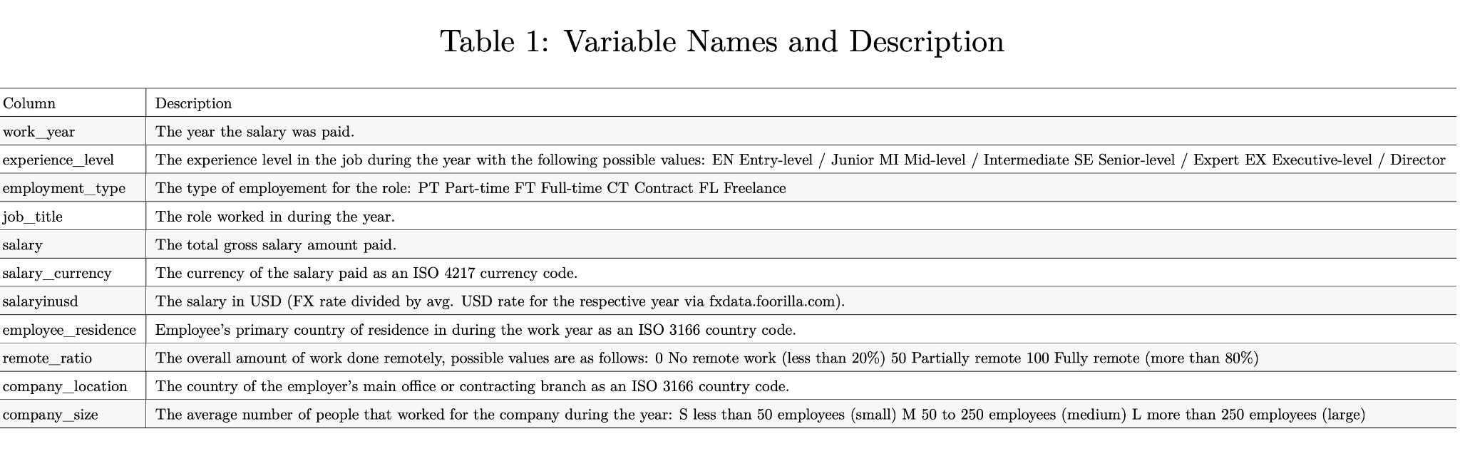
Data Overview
Shape of dataset
NaN values
Data Preprocessing (change datatype of columns, drop repetitive columns, etc)

Slide 10
Limitations
Approx. 700 rows
Limited predictors (11)
Most data is from US (No data from Africa or Australia)

Slide 11
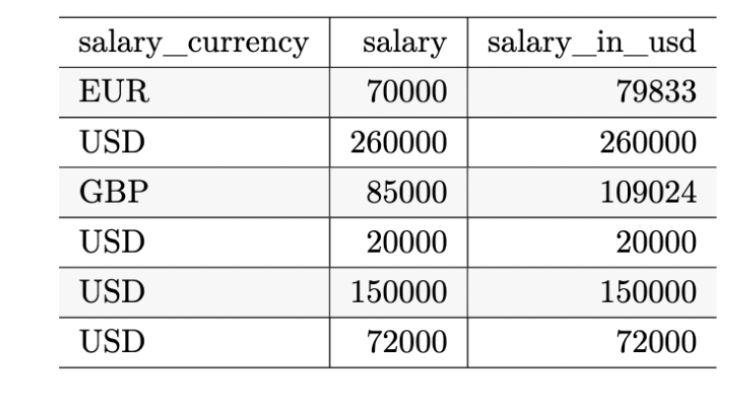
Salary, Currency, or Salary in USD?
Currency
Salary
Salary in USD

Slide 12


Salary, Currency, or Salary in USD?
Salary in USD

Slide 13
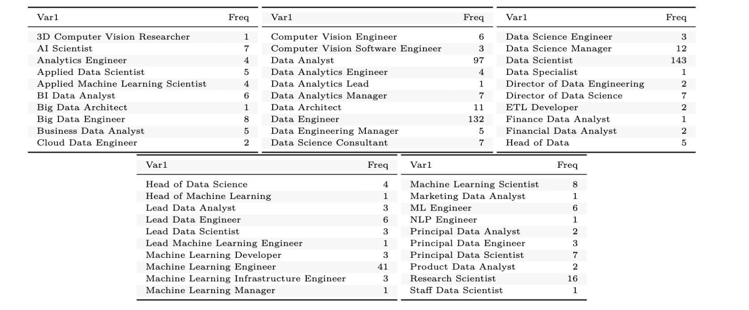
Data Cleaning: Job Title

Slide 14
Data Cleaned: Job Title New Distributions
Data Engineer: 181
Data Scientist: 209
Data Analyst: 134
Machine Learning Engineer: 63

Slide 15
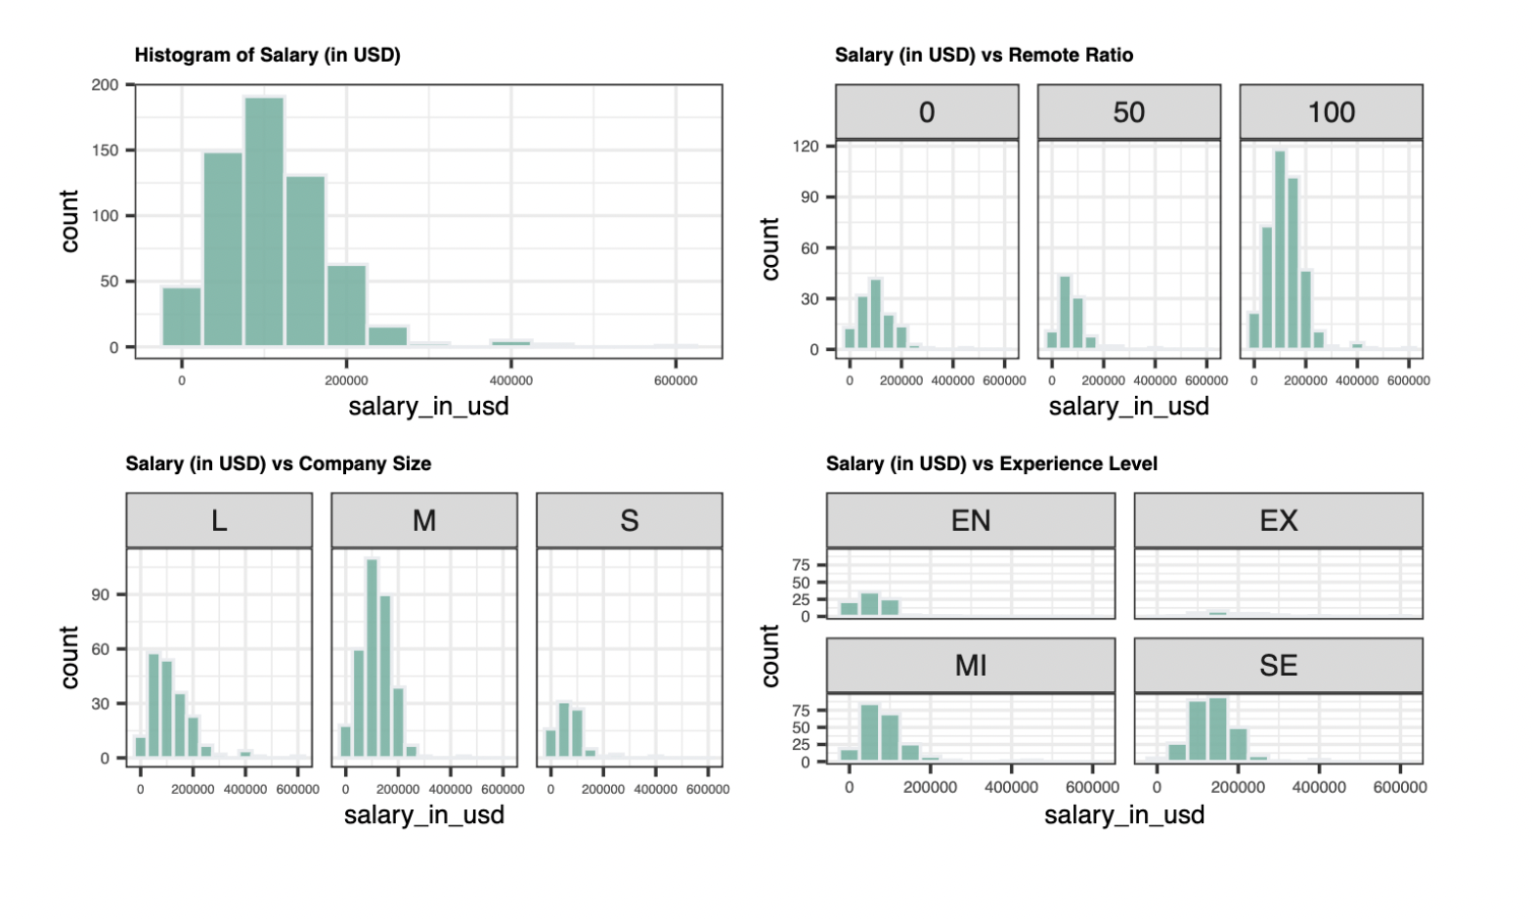
Data Visualization
Salary
Salary
Salary
Salary

Slide 16
Methods
We have used one model for each question:
Multivariate Linear Regression for salary
Output: Continuous, Salary in USD
Multinomial Logistic Regression for remote ratio
Output: 3 levels: Remote, Hybrid, or In Person

Slide 17
Results: Salary
Adjusted R-Squared: 0.5372
Significant Predictors:
Company Location, Experience Level, Job Title

Slide 18
Results: Salary, Job Title?
Coefficients on Job Title, with ‘Data Engineer’ as Reference
Job Title = Machine Learning Engineer: $15,202
Job Title = Data Scientist: $7,386
Job Title = Data Analyst: $-26,860

Slide 19
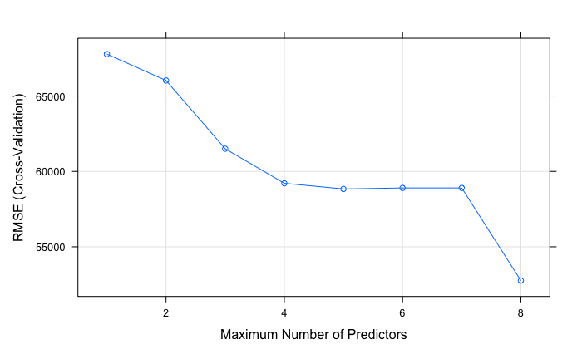
Salary: RSME

Slide 20
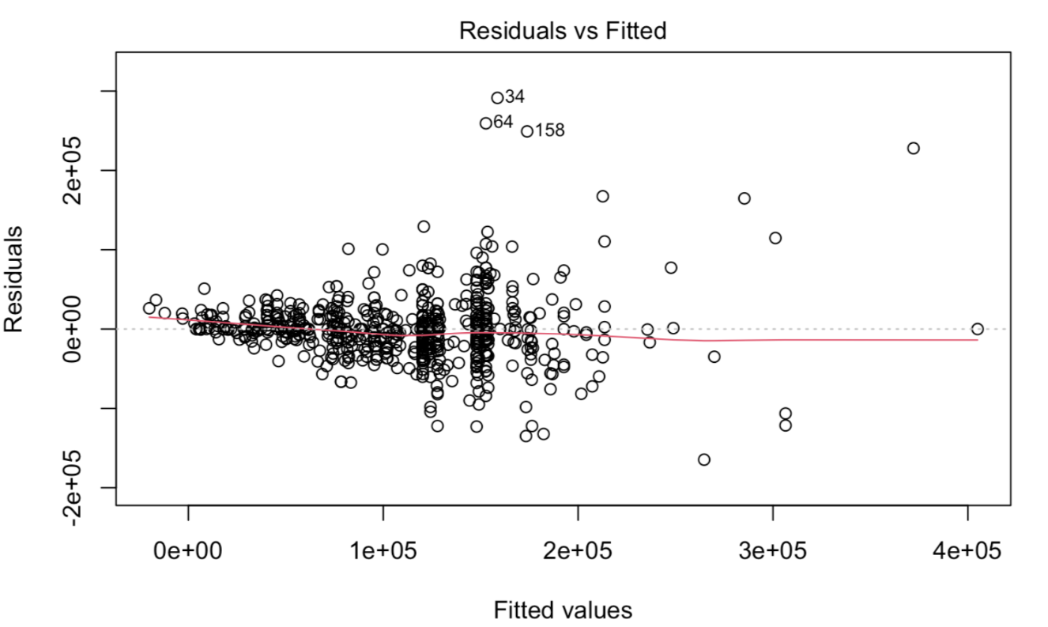

Slide 21
Funneling?

Slide 22
No!
Equal Variance of Errors!

Slide 23
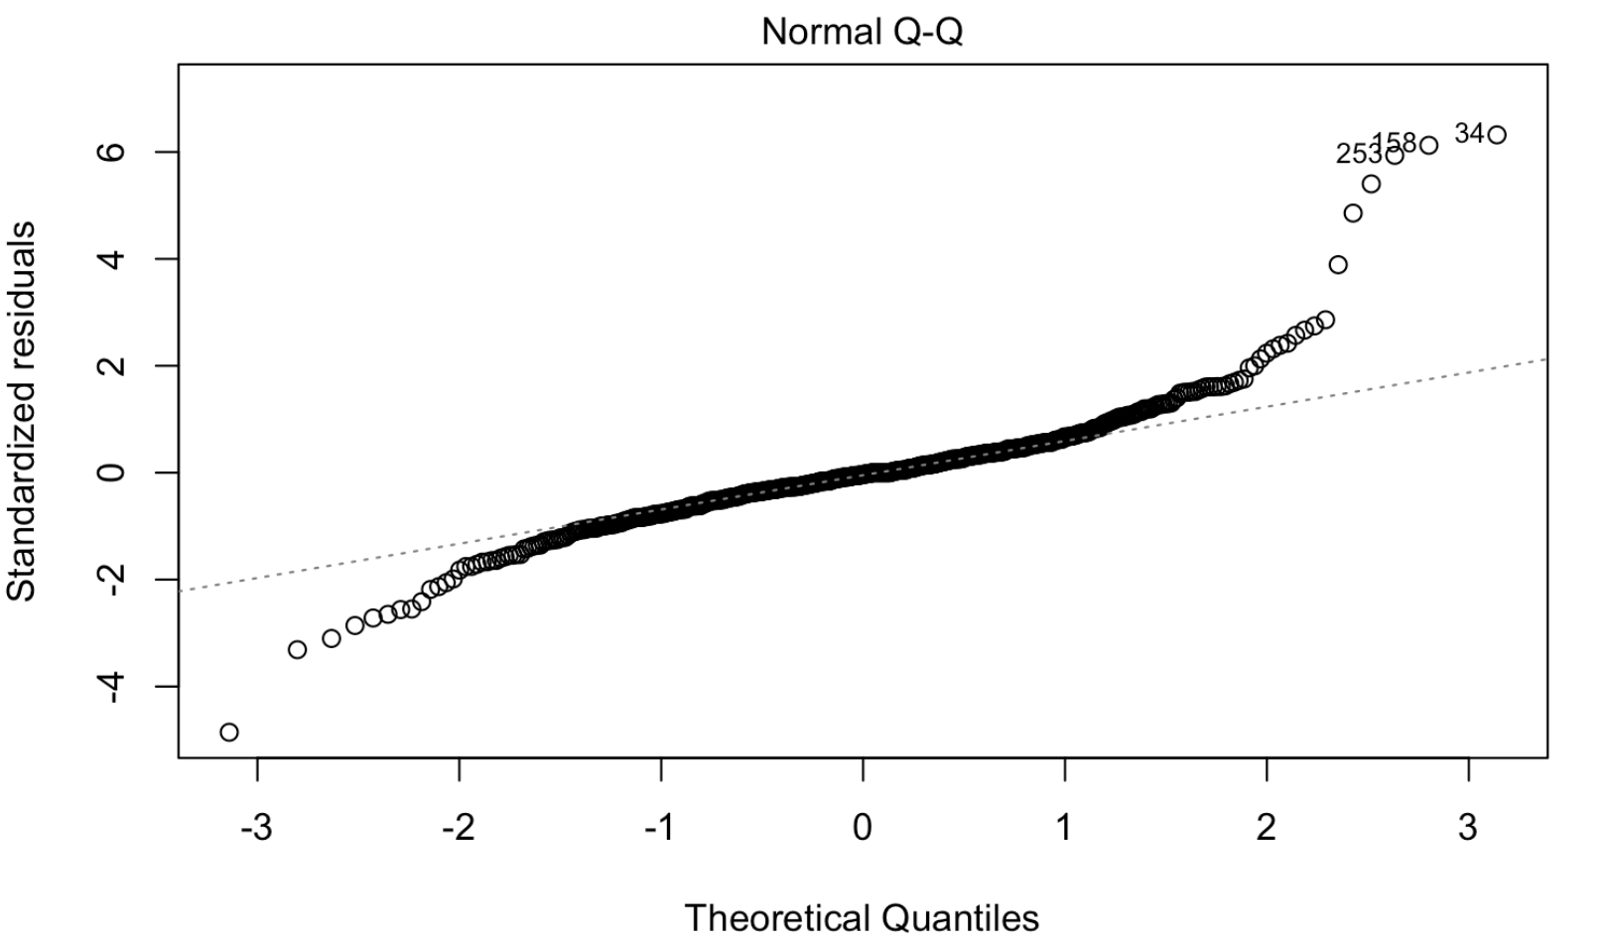

Slide 24
Do the dots follow the line?

Slide 25
Yes! Errors are Normally Distributed!

Slide 26

Now let’s pivot to our Remote Ratio question for Mike…

Slide 27
Results: Remote Ratio
Prediction Accuracy: 0.645
Significant Predictors:
Company Location, Employment Type, Job Title

Slide 28
Results: Remote Ratio, Job Title?
Coefficients on Job Title, with ‘Data Engineer’ as Reference
Job Title = Machine Learning Engineer: -0.03
Job Title = Data Scientist: -0.46
Job Title = Data Analyst: 0.07

Slide 29
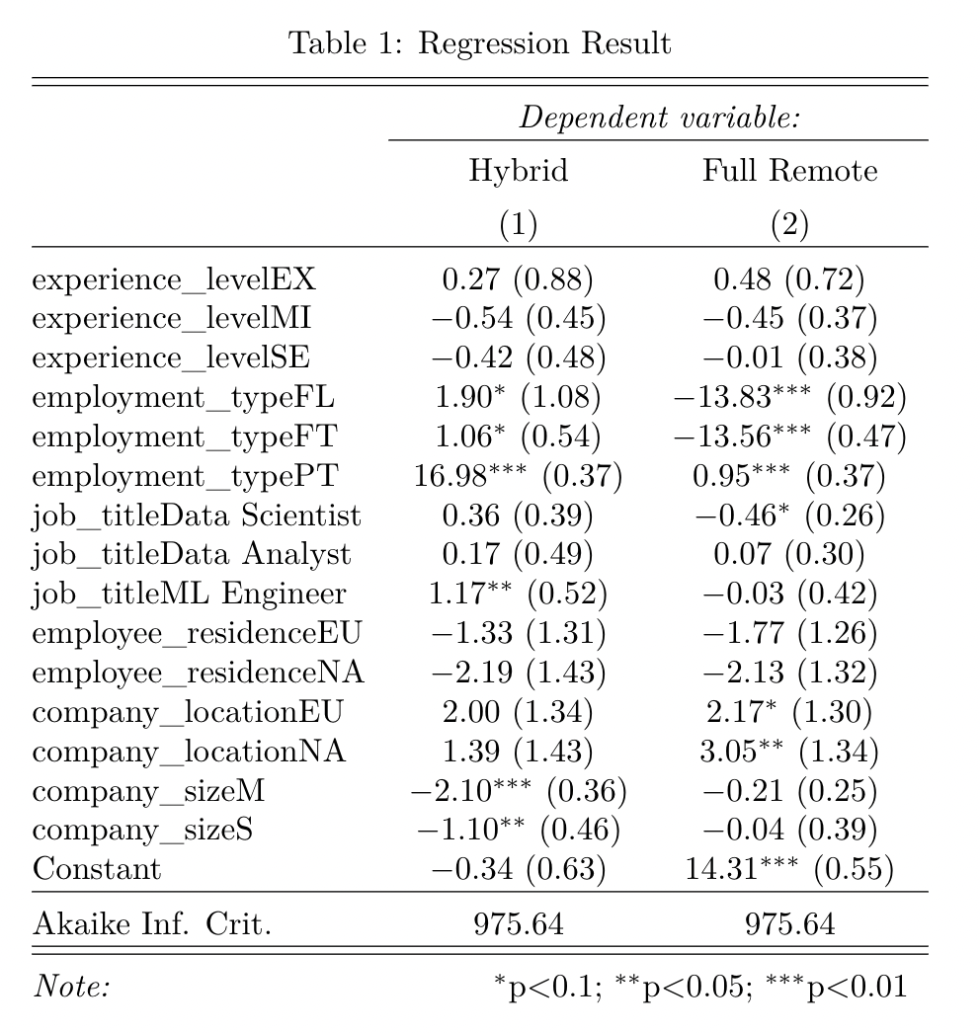

Slide 30
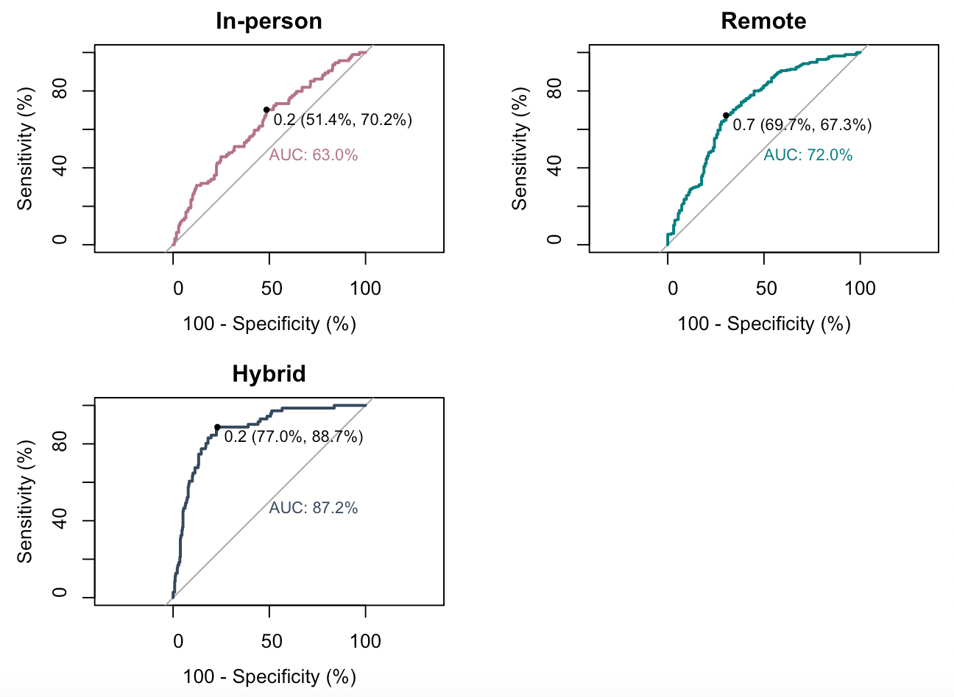

Slide 31
Conclusion

Slide 32
With what we’ve just learned, what job should Mike take?
Machine Learning Engineer: Remote
Data Scientist: In Person
Data Analyst: Remote

Slide 33


Machine Learning Engineer

Slide 34
Have fun at work, Mike!
Machine Learning Engineer

Slide 35
Questions?

Slide 36
Thank you!
LGTM!!!

Slide 37
References
https://www.kaggle.com/datasets/ruchi798/data-science-job-salaries
Andrea Lane, Ph.D

Slide 38
Future Work:
LGTM!!!!

